Slide 1
CIS655 Computer Architecture/ CSE 661 Advanced Computer Architecture Spring 2023
Network On–Chip (NoC) using Photonics for High-Performance Computing Systems
Team Members
Sunidhi Jain(SUID: 551562436)
Lavesh Jaykar(SUID: 358866526)
Swapnil Bhalerao(SUID: 271146735)
Mosali Abhinav Reddy(SUID: 700918912)

Slide 2
Introduction
High-Performance Computing systems are advanced in a way that all scientific sophisticated challenges are addressed here for computation. The demand in need for computational power requires innovative solutions to overcome the existing conclusions. Similar drawback is the bottleneck performance in traditional electronic-based -Network-on-chip (NOC) architectures. Photonic Network-on-Chip (PNOC) are known for a transformative approach by integrating photonic communications into the network on-chip offering higher bandwidth, low latency enhanced energy efficiency. The proposal here aims to develop design and evaluate PNoC architectures significantly to enhance the performance and ease of use of HPC systems

Slide 3

Chip Multiprocessors (CMP)?
CMP (Chip MultiProcessor) is a design integrating multiple independent processor cores onto a single chip.
Allowing for simultaneous task handling and enhancing the chip's power and efficiency for diverse computing applications.
CMPs are designed to share resources like cache memory and communication pathways among these cores.

Slide 4
Networks on Chip (NoC)
Networks on Chip (NoC) are specialized communication infrastructures within computer chips.
They use a network of routers and links to efficiently transfer data between different parts of the chip.
It improves scalability, flexibility, and overall performance compared to traditional bus-based architectures

Slide 5
Electronic On-chip Network
Electronic On-Chip Network (EOCN) is a network system within a microchip designed to connect and facilitate communication between various internal components, such as processor cores, memory, and I/O interfaces, on a single integrated circuit.
An example of an electronic on-chip network is the ARM CoreLink NIC-400 Network Interconnect.
Pros
Efficient Data Communication
Scalability
Parallel Processing
Cons
Increased Power Consumption
Heat Generation
Design Complexity

Slide 6
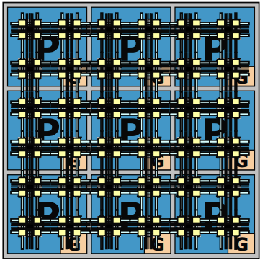
Photonic On-chip Network
A Photonic On-Chip Network (PON) refers to a type of network within a microchip that uses light (photons) for communication instead of traditional electronic signals.
Intel Silicon Photonics is an example of a Photonic On-Chip Network, integrating photonic devices on silicon chips for high-speed, high-bandwidth data communication in computing systems.

Slide 7
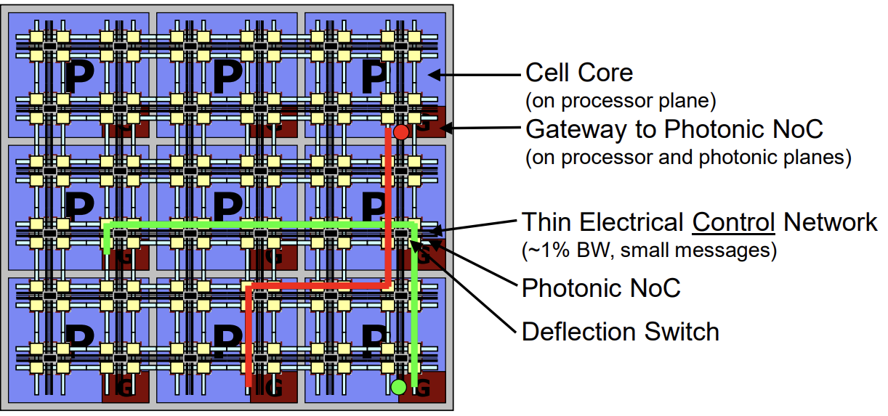
Photonic On-Chip Network Architecture

Slide 8
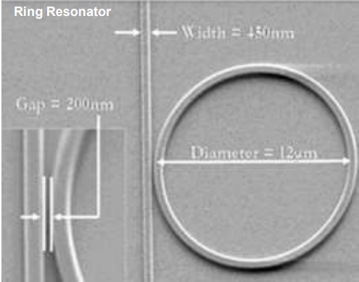

Building Blocks Of Photonic Modulator
Ring-resonator structure
Compact 10µm diameter for high density integration
Electro-Optic Material Lithium Niobate (LiNbO3)
Broadband deflection switch
ON state: – carrier injection to coupling into ring to signal switched ~0.5mW
Of state:- passive waveguide crossover
negligible power

Slide 9
Power Analysis of Photonic Network
A power analysis of a Photonic On-Chip Network (PON) involves evaluating the energy efficiency and power consumption characteristics of the network.
Low Power Signal Transmission.
Energy Efficiency at High Data Rates.
Thermal Effects and Cooling Costs.
Static Power Consumption.
Integration with Electronic Components.
Power Overhead of Supporting Infrastructure.

Slide 10
Performance Analysis on Photonic Network
Bandwidth and Data Transfer Rates.
Latency.
Energy Efficiency.
Scalability.
Thermal Management.
Error Rates and Signal Integrity.
Integration and Interoperability.
Reliability and Durability.

Slide 11
Advantages

Slide 12
Conclusion:

Slide 13
References:

Slide 14
References:
(4) Aigner, M., & Ochoa, M. (2017). “A survey on side-channel attacks and their countermeasures in cryptographic systems”. ACM Computing Surveys, 50(2), 1-45.
(5) H. Wang et al., "Mitigating Cache-Based Side-Channel Attacks through Randomization: A Comprehensive System and Architecture Level Analysis," 2020 Design, Automation & Test in Europe Conference & Exhibition (DATE), Grenoble, France, 2020, pp. 1414-1419, doi: 10.23919/DATE48585.2020.9116340.

Slide 15
Thank You!

